Slide 1
Chapter 3:
Modeling Data in the Organization
Modern Database Management
6th Edition
Jeffrey A. Hoffer, Mary B. Prescott, Fred R. McFadden

Slide 2
SDLC Revisited – Data Modeling is an Analysis Activity
Project Identification
and Selection
Project Initiation
and Planning
Analysis
Logical Design
Physical Design
Database activity –
conceptual data modeling
Implementation
Maintenance
© Prentice Hall, 2002

Slide 3
Business Rules
Statements that define or constrain some aspect of the business
Control/influence business behavior
Expressed in terms familiar to end users
© Prentice Hall, 2002

Slide 4
A Good Business Rule is:
Declarative – what, not how
Precise – clear, agreed-upon meaning
Atomic – one statement
Consistent – internally and externally
Expressible – structured, natural language
Distinct – non-redundant
Business-oriented – understood by business people
© Prentice Hall, 2002

Slide 5
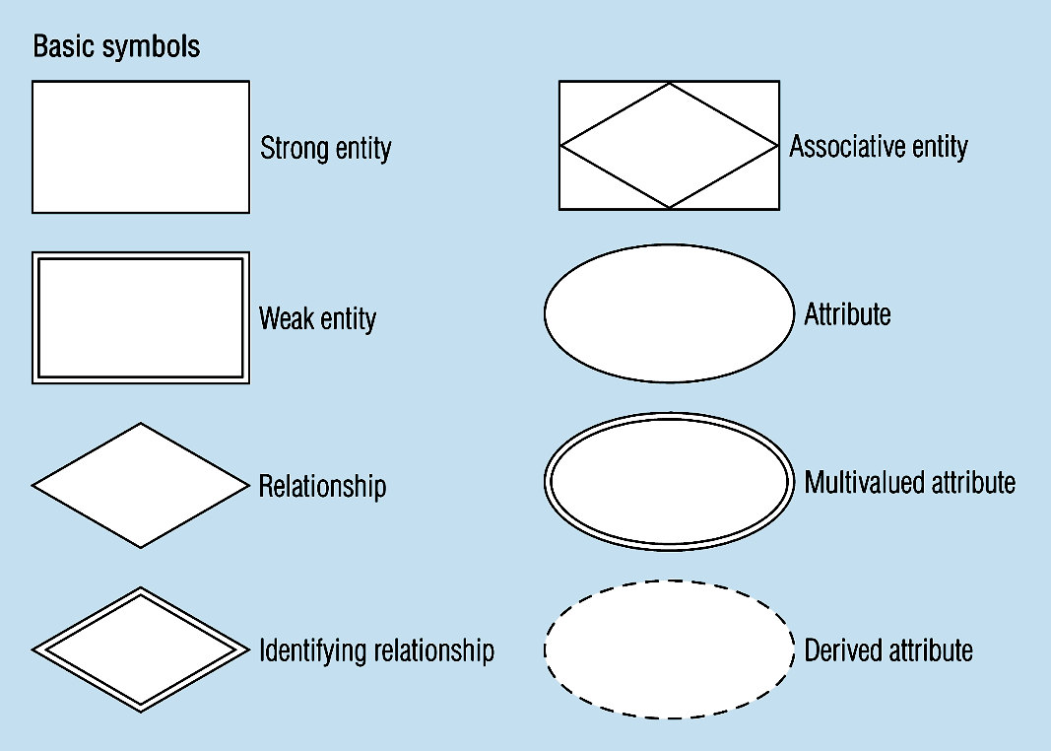
Figure 3-2 -- Basic E-R Notation
A special entity that is also a relationship
Entity symbols
Attribute symbols
Relationship symbols
© Prentice Hall, 2002
Notes:
8

Slide 6
E-R Model Constructs
Entity instance
Entity Type
Attribute
Relationship instance
Relationship type
© Prentice Hall, 2002
Notes:
2

Slide 7
E-R Model Constructs
Entities
  Person : Employee, student, patient
  Place : Store, warehouse, state
  Object : Machine, building, automobile
  Event : sale, registration, renewal
  Concept : account, course, work center
Entity instance - often corresponds to a row in a table
Entity Type – collection of entities (often corresponds to a table)
© Prentice Hall, 2002
Notes:
2

Slide 8
What Should an Entity Be?
SHOULD BE:
  An object that will have many instances in the database
  An object that will be composed of multiple attributes
  An object that we are trying to model
SHOULD NOT BE:
  A user of the database system
  An output of the database system (e.g. a report)
© Prentice Hall, 2002

Slide 9
Strong vs. Weak Entities, and
Identifying Relationships
Strong entities
  exist independently of other types of entities
  has its own unique identifier
  represented with single-line rectangle
Weak entity
  dependent on a strong entity…cannot exist on its own
  Does not have a unique identifier
  represented with double-line rectangle
Identifying relationship
  links strong entities to weak entities
  represented with double line diamond
© Prentice Hall, 2002

Slide 10
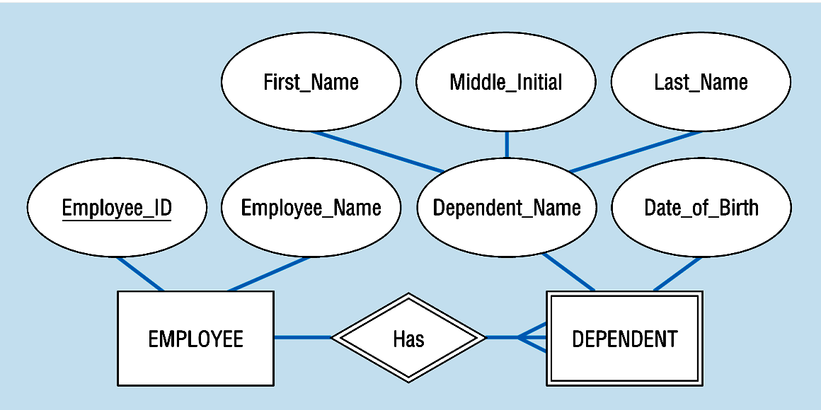
Figure 3-5: Strong and weak entities
Strong entity
Identifying relationship
Weak entity
© Prentice Hall, 2002

Slide 11
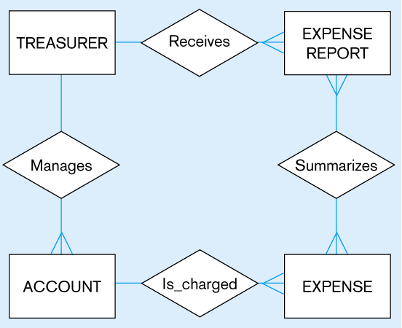
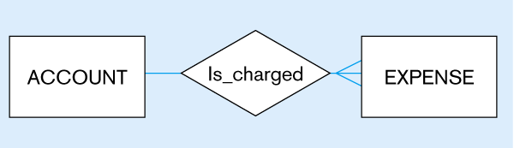
Figure 3-4
Inappropriate entities
System user
System output
Appropriate entities
© Prentice Hall, 2002

Slide 12
E-R Model Constructs
Entity instance
Entity Type
Attribute
Relationship instance
Relationship type
© Prentice Hall, 2002
Notes:
2

Slide 13
Attributes
Attribute - property or characteristic of an entity type
Classifications of attributes:
  Simple versus Composite Attribute
  Single-Valued versus Multivalued Attribute
  Stored versus Derived Attributes
  Identifier Attributes
© Prentice Hall, 2002
Notes:
5

Slide 14
Identifiers (Keys)
Identifier (Key) - An attribute (or combination of attributes) that uniquely identifies individual instances of an entity type
Simple Key versus Composite Key
Candidate Key – an attribute that could be a key…satisfies the requirements for being a key
© Prentice Hall, 2002
Notes:
6

Slide 15
Characteristics of Identifiers
Will not change in value
Will not be null
No intelligent identifiers (e.g. containing locations or people that might change)
© Prentice Hall, 2002
Notes:
7

Slide 16
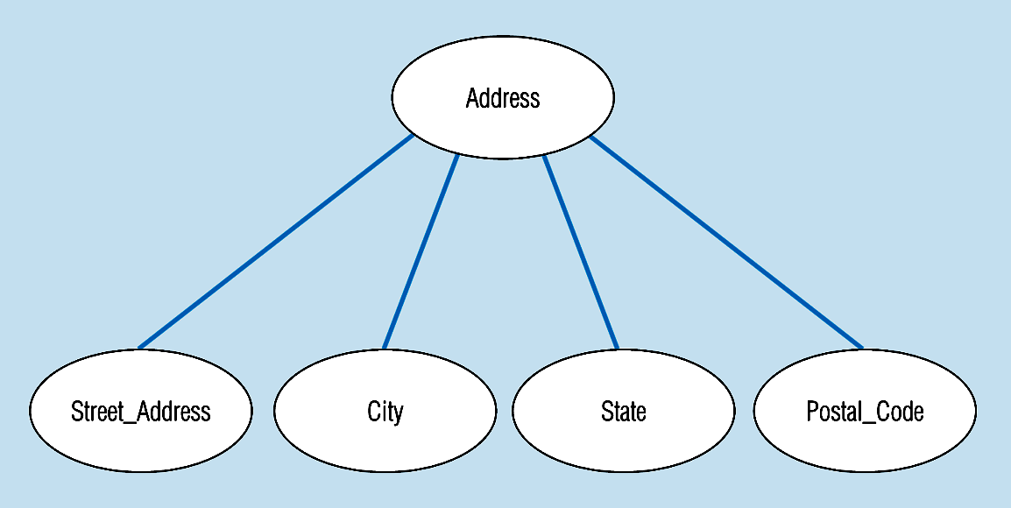
Figure 3-7 -- A composite attribute
An attribute broken into component parts
© Prentice Hall, 2002
Notes:
12

Slide 17

Figure 3-9a – Simple key attribute
The key is underlined
© Prentice Hall, 2002
Notes:
14

Slide 18
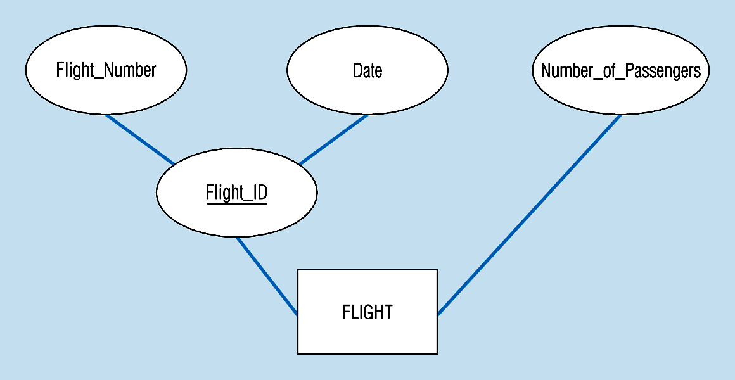
Figure 3-9b -- Composite key attribute
The key is composed
of two subparts
© Prentice Hall, 2002
Notes:
15

Slide 19
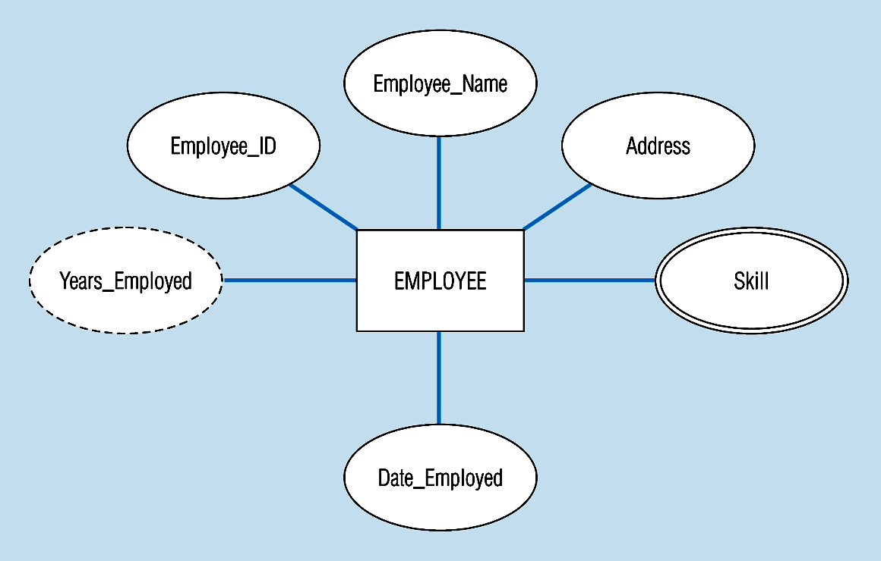
Figure 3-8 -- Entity with a multivalued attribute (Skill) and derived attribute (Years_Employed)
What’s wrong with this?
Multivalued:
an employee can have
more than one skill
Derived
from date employed and current date
© Prentice Hall, 2002
Notes:
13

Slide 20
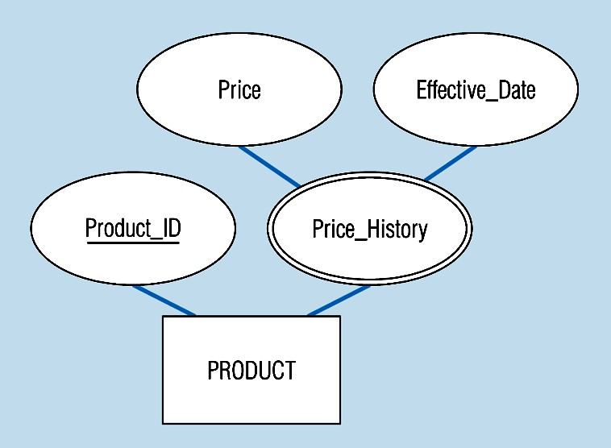
Figure 3-19 – an attribute that is both multivalued and composite
This is an example of time-stamping
© Prentice Hall, 2002
Notes:
37

Slide 21
More on Relationships
Relationship Types vs. Relationship Instances
  The relationship type is modeled as the diamond and lines between entity types…the instance is between specific entity instances
Relationships can have attributes
  These describe features pertaining to the association between the entities in the relationship
Two entities can have more than one type of relationship between them (multiple relationships)
Associative Entity = combination of relationship and entity
  More on this later
© Prentice Hall, 2002

Slide 22
Degree of Relationships
Degree of a Relationship is the number of entity types that participate in it
  Unary Relationship
  Binary Relationship
  Ternary Relationship
© Prentice Hall, 2002
Notes:
16

Slide 23
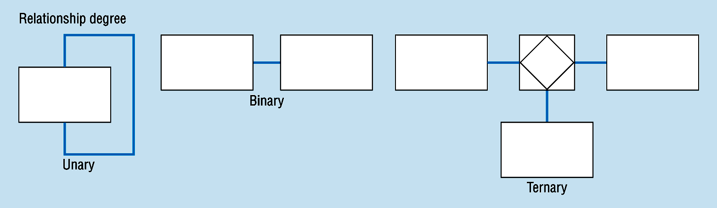
Degree of relationships – from figure 3-2
One entity related to another of the same entity type
Entities of two different types related to each other
Entities of three different types related to each other
© Prentice Hall, 2002
Notes:
8

Slide 24
Cardinality of Relationships
One – to – One
  Each entity in the relationship will have exactly one related entity
One – to – Many
  An entity on one side of the relationship can have many related entities, but an entity on the other side will have a maximum of one related entity
Many – to – Many
  Entities on both sides of the relationship can have many related entities on the other side
© Prentice Hall, 2002

Slide 25
Cardinality Constraints
Cardinality Constraints - the number of instances of one entity that can or must be associated with each instance of another entity.
Minimum Cardinality
  If zero, then optional
  If one or more, then mandatory
Maximum Cardinality
  The maximum number
© Prentice Hall, 2002
Notes:
29

Slide 26
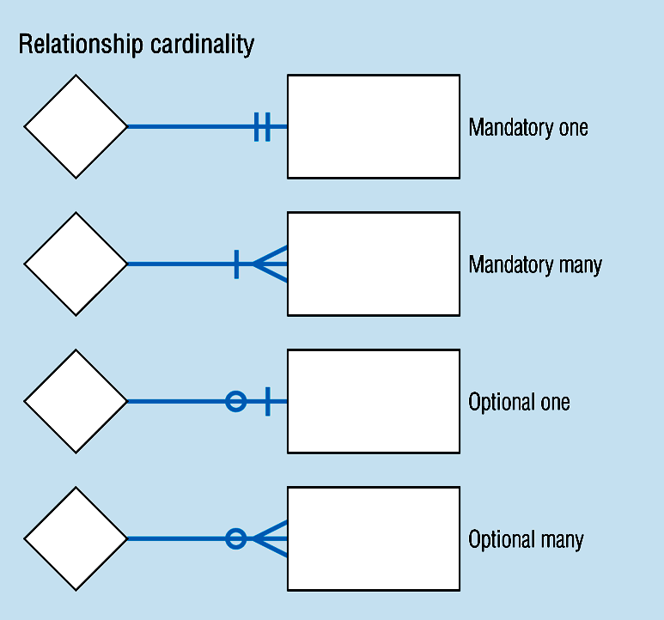
Cardinality – figure 3-2
© Prentice Hall, 2002
Notes:
8

Slide 27
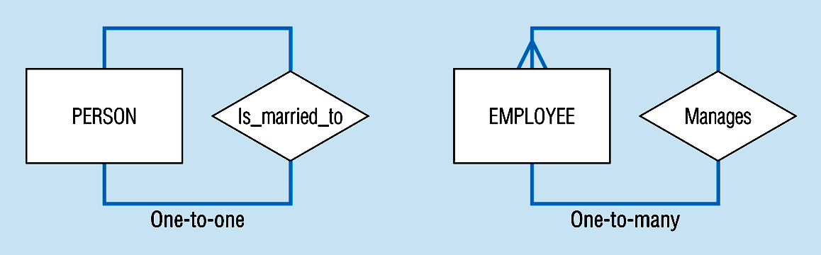
Unary relationships -- figure 3-12a
© Prentice Hall, 2002
Notes:
22

Slide 28
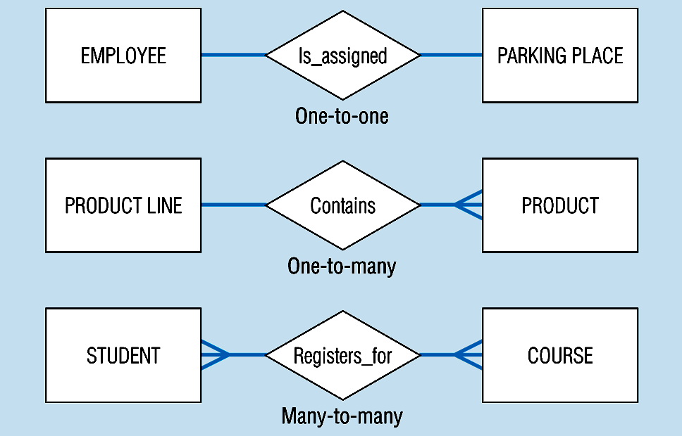
Binary relationships – figure 3-12b
© Prentice Hall, 2002
Notes:
23

Slide 29
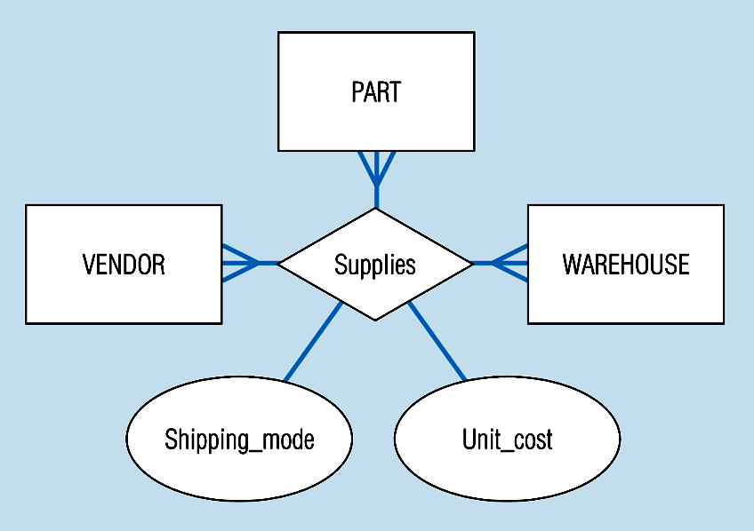
Ternary relationships –figure 3-12c
Note: a relationship can have attributes of its own
© Prentice Hall, 2002
Notes:
24

Slide 30

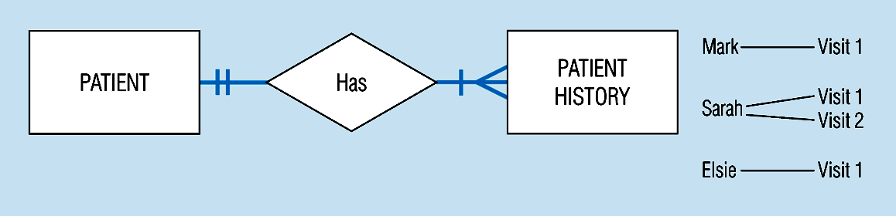
Basic relationship with only maximum cardinalities showing –
figure 3-16a
Mandatory minimum cardinalities – figure 3-17a
© Prentice Hall, 2002
Notes:
1

Slide 31
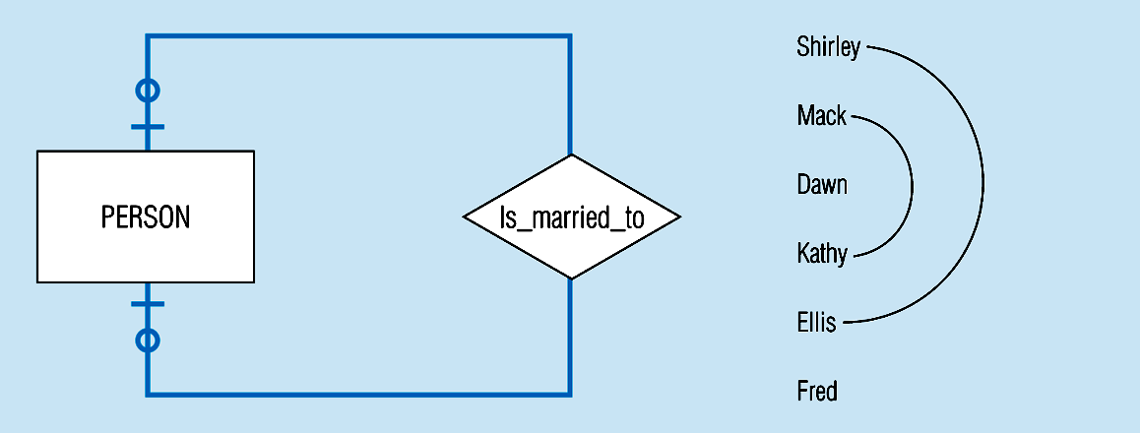
Figure 3-17c
Optional cardinalities with unary degree, one-to-one relationship
© Prentice Hall, 2002
Notes:
34

Slide 32
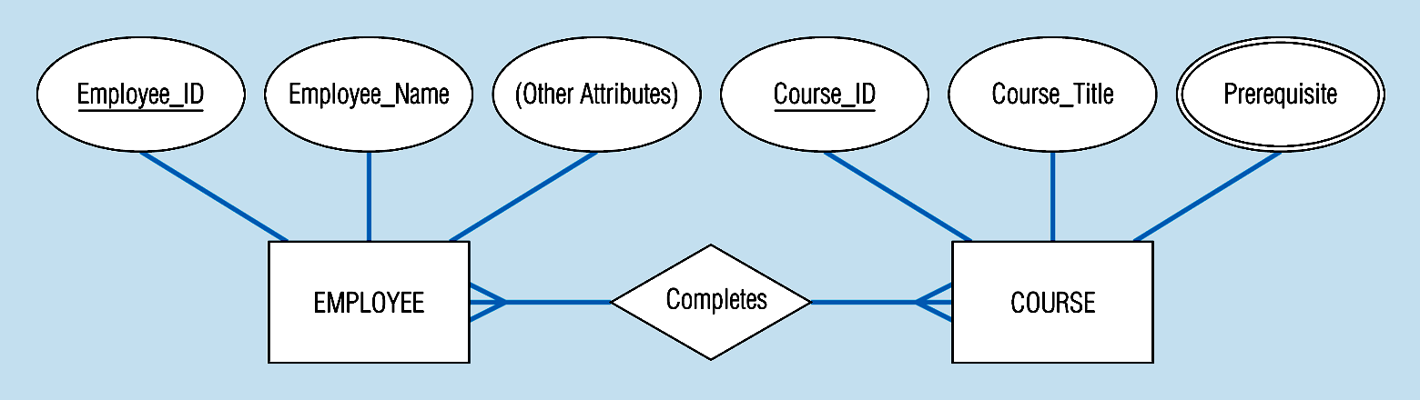
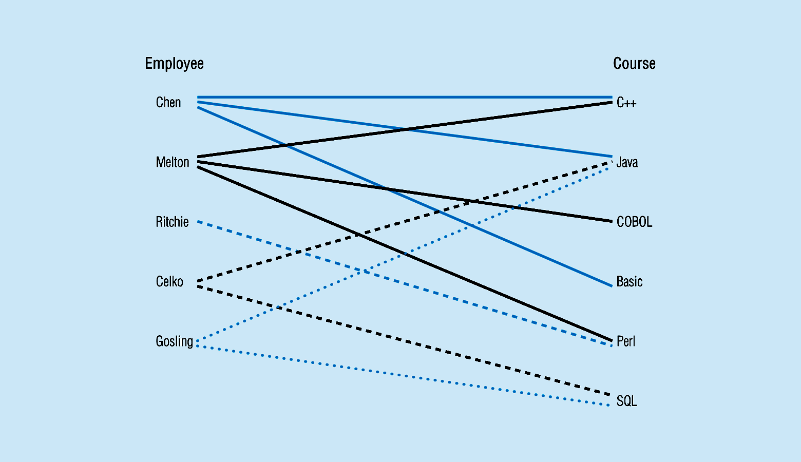
Figure 3-10a Relationship type
3-10b Entity and Relationship instances
© Prentice Hall, 2002
Notes:
17

Slide 33
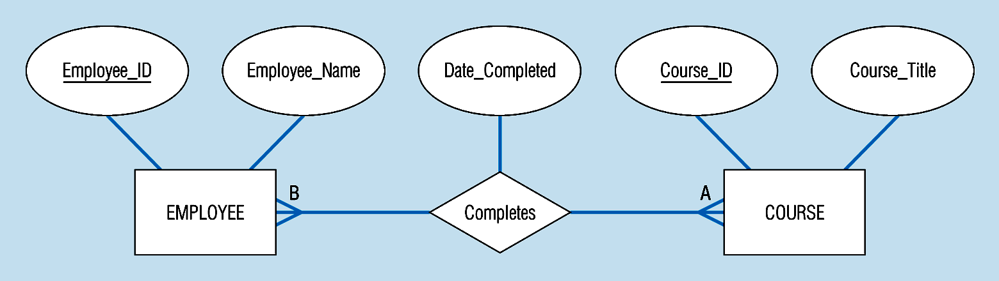
Figure 3-11a A binary relationship with an attribute
Here, the date completed attribute pertains specifically to the employee’s completion of a course…it is an attribute of the relationship
© Prentice Hall, 2002
Notes:
20

Slide 34
Associative Entities
It’s an entity – it has attributes
AND it’s a relationship – it links entities together
When should a relationship with attributes instead be an associative entity?
  All relationships for the associative entity should be many
  The associative entity could have meaning independent of the other entities
  The associative entity preferably has a unique identifier, and should also have other attributes
  The associative may be participating in other relationships other than the entities of the associated relationship
  Ternary relationships should be converted to associative entities
© Prentice Hall, 2002

Slide 35
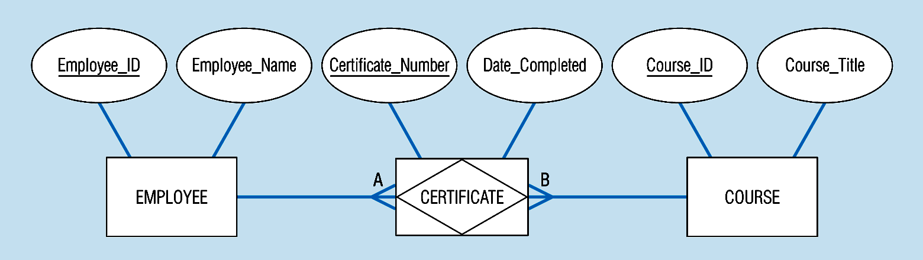
Figure 3-11b: An associative entity (CERTIFICATE)
Associative entity involves a rectangle with a diamond inside.
Note that the many-to-many cardinality symbols face toward the associative entity and not toward the other entities
© Prentice Hall, 2002
Notes:
21

Slide 36
Figure 3-12c -- A ternary relationship with attributes
© Prentice Hall, 2002
Notes:
24

Slide 37
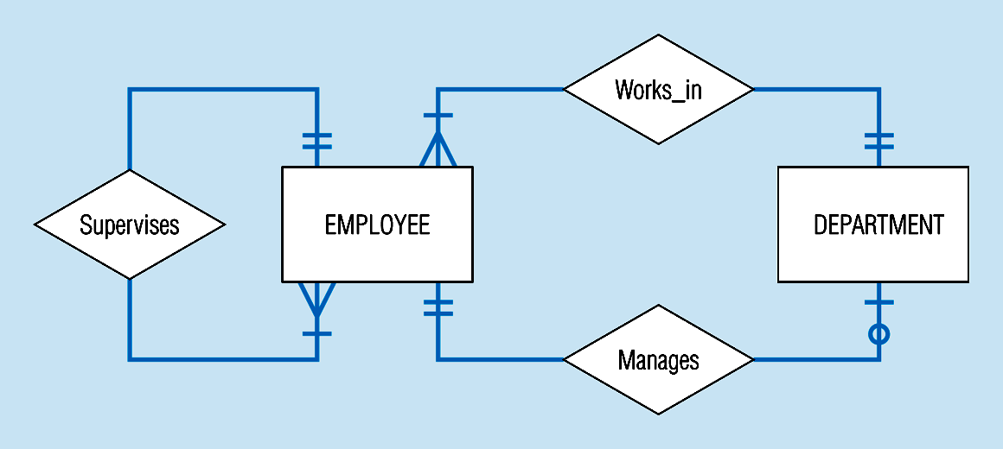
Examples of multiple relationships – entities can be related to one another in more than one way
Figure 3-21a Employees and departments
© Prentice Hall, 2002
Notes:
40

Slide 38
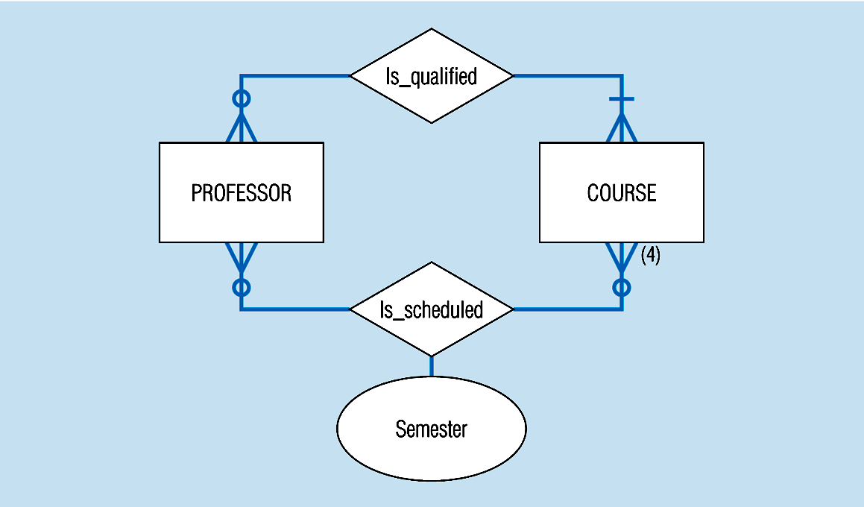
Figure 3-21b -- Professors and courses (fixed upon constraint)
Here,max cardinality constraint is 4
© Prentice Hall, 2002
Notes:
41

